Slide 1
Final Project
By: Shorya Kohli, Elliot Blasko, Trevor Klingensmith

Slide 2
Introduction
Using the datasets provided by the WPRDC, we narrowed down the factors for the best neighborhoods in Pittsburgh to:
Playgrounds
Playground Equipment
Smart Trash Cans
Playground data was our main factor for determining a good neighborhood because most known neighborhoods usually have playgrounds associated with them to entice residents. So, finding out how many playgrounds are in a specific neighborhood will narrow down the most notable of all the others. Along with playgrounds comes the equipment that is included with them, such as slides, swing sets, monkey bars, etc. The more equipment a playground has to offer its visitors/residents, the more likely the neighborhoods reputation will increase in popularity due to variety in activity. Finally, smart trash cans are used in a way to cut costs and improve efficiency in waste collection. Pittsburgh has deployed more than 1,200 of these smart trash cans to neighborhoods.

Slide 3
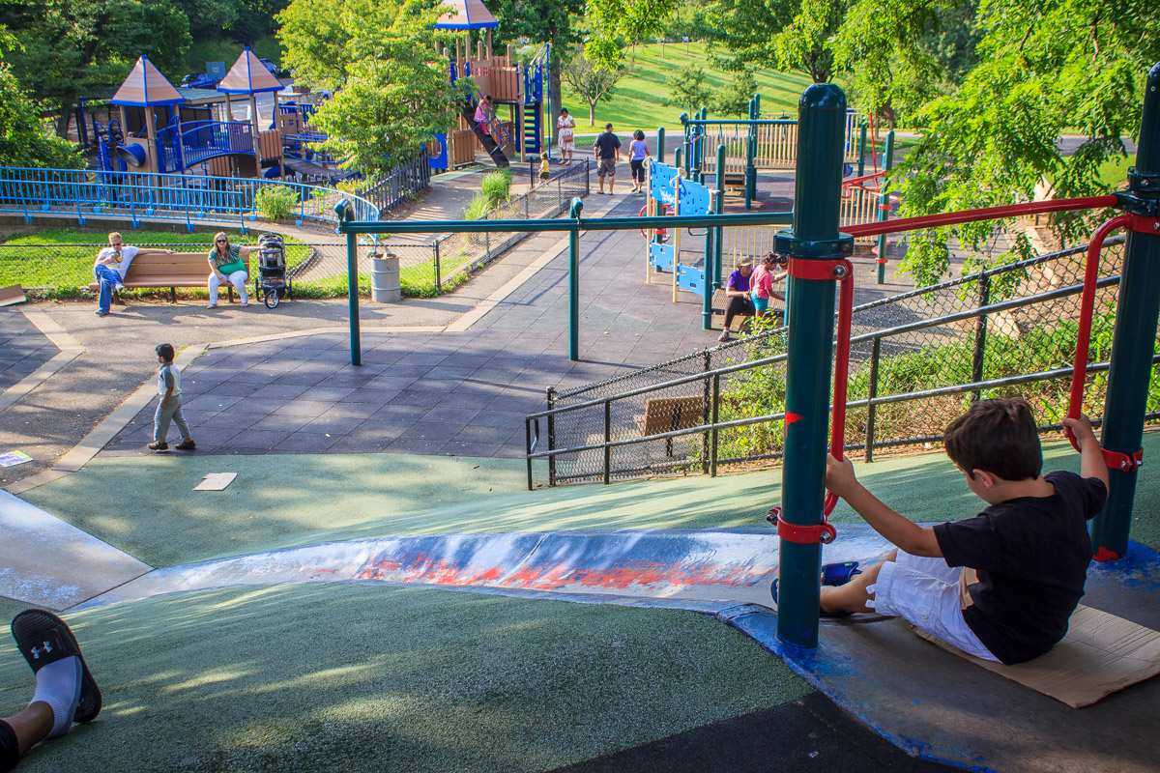
Playgrounds and Recreation
Playgrounds, at least for younger folk, are an enjoyable way to interact with your community and see what your neighborhood as to offer. Modern Playgrounds often have recreational equipment such as the seesaw, merry-go-round, swingset, slide, jungle gym, sandbox, and playhouses. We will be looking at both the number of playgrounds as well as the average amount of playground equipment per playground in a neighborhood to help determine what we will consider the best neighborhood

Slide 4
Playground Scoring System
Step 1: # of Playgrounds per neighborhood
1 Playground = 1 point
(ex. “Neighborhood A” has 7 playgrounds = 7 points)
Step 2: Avg. # of Playground Equipment (per neighborhood)
Quality over Quantity
Multiply the original scores of the playgrounds by (1 + x/10) of the average “x” playground equipment in the neighborhood
(ex. “Neighborhood A” has an average of 4 pieces of playground equipment per playground
(1 + 4/10) = 1.4
7 * 1.4 = 9.8
The new score for “Neighborhood A” is 9.8

Slide 5
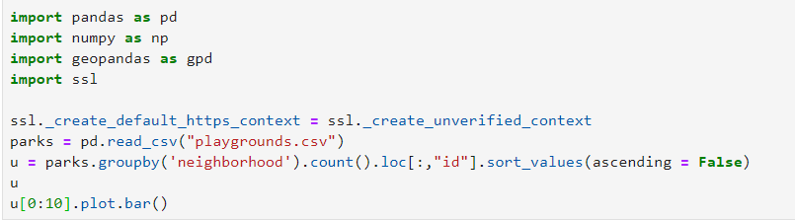
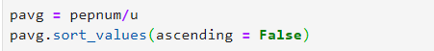
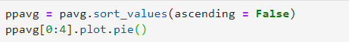
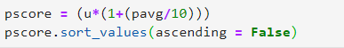
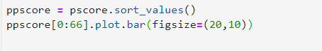
Playground Code (In Order of Appearance)
https://github.com/trk55/parks-and-trash

Slide 6
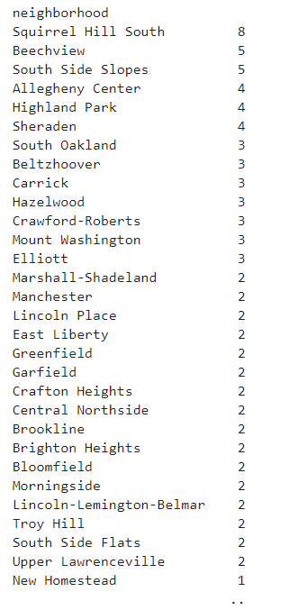
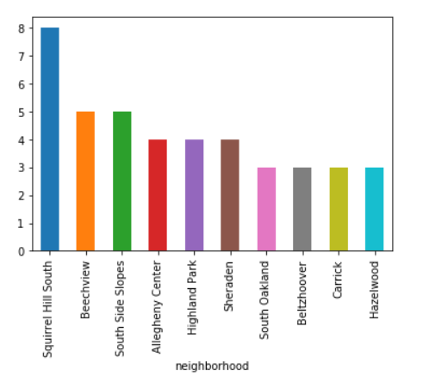
Playgrounds By The Numbers
Notes:
We see here the top 3 neighborhoods being Squirrel Hill South, Beechview, and Southside Slopes, As we go down we see that most neighborhoods usually have around 3-1 playgrounds.

Slide 7
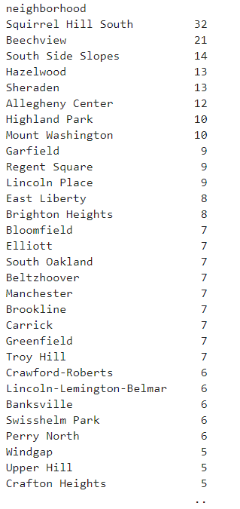
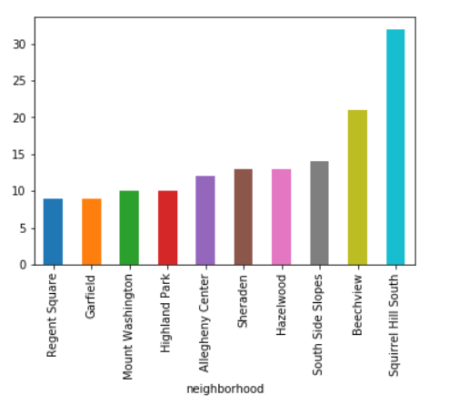
Playgrounds By The Equipment
Notes:
Top 3 again are Squirrel Hill South, Beechview, and South Side Slopes.

Slide 8
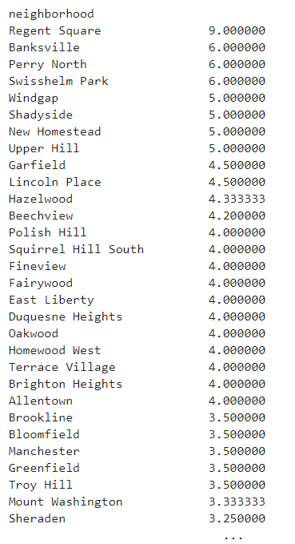
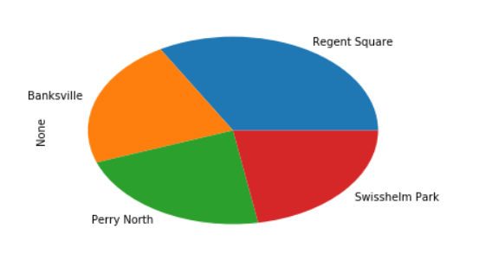
Averaging Equipment In Neighborhoods
Notes:
Regent Square was the only neighborhood to appear anywhere on the last two graphs

Slide 9
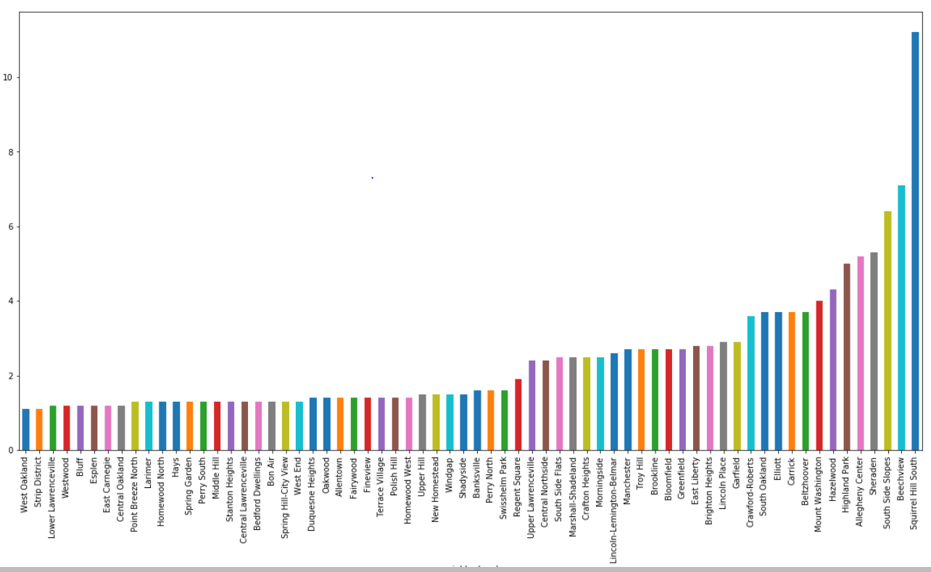
Notes:
While not surprising at the outcomes it is important to note cases such as Sheraden, who had placed 5th in both # of playgrounds and # of playground equipment in a neighbor, was actually able to secure the 4th place spot because of this ranking process. OUTLIER: Squirrel Hill North was recorded to have 1 playground, however it has no record of # of playground equipment.

Slide 10
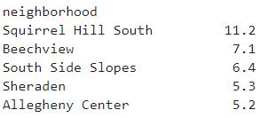
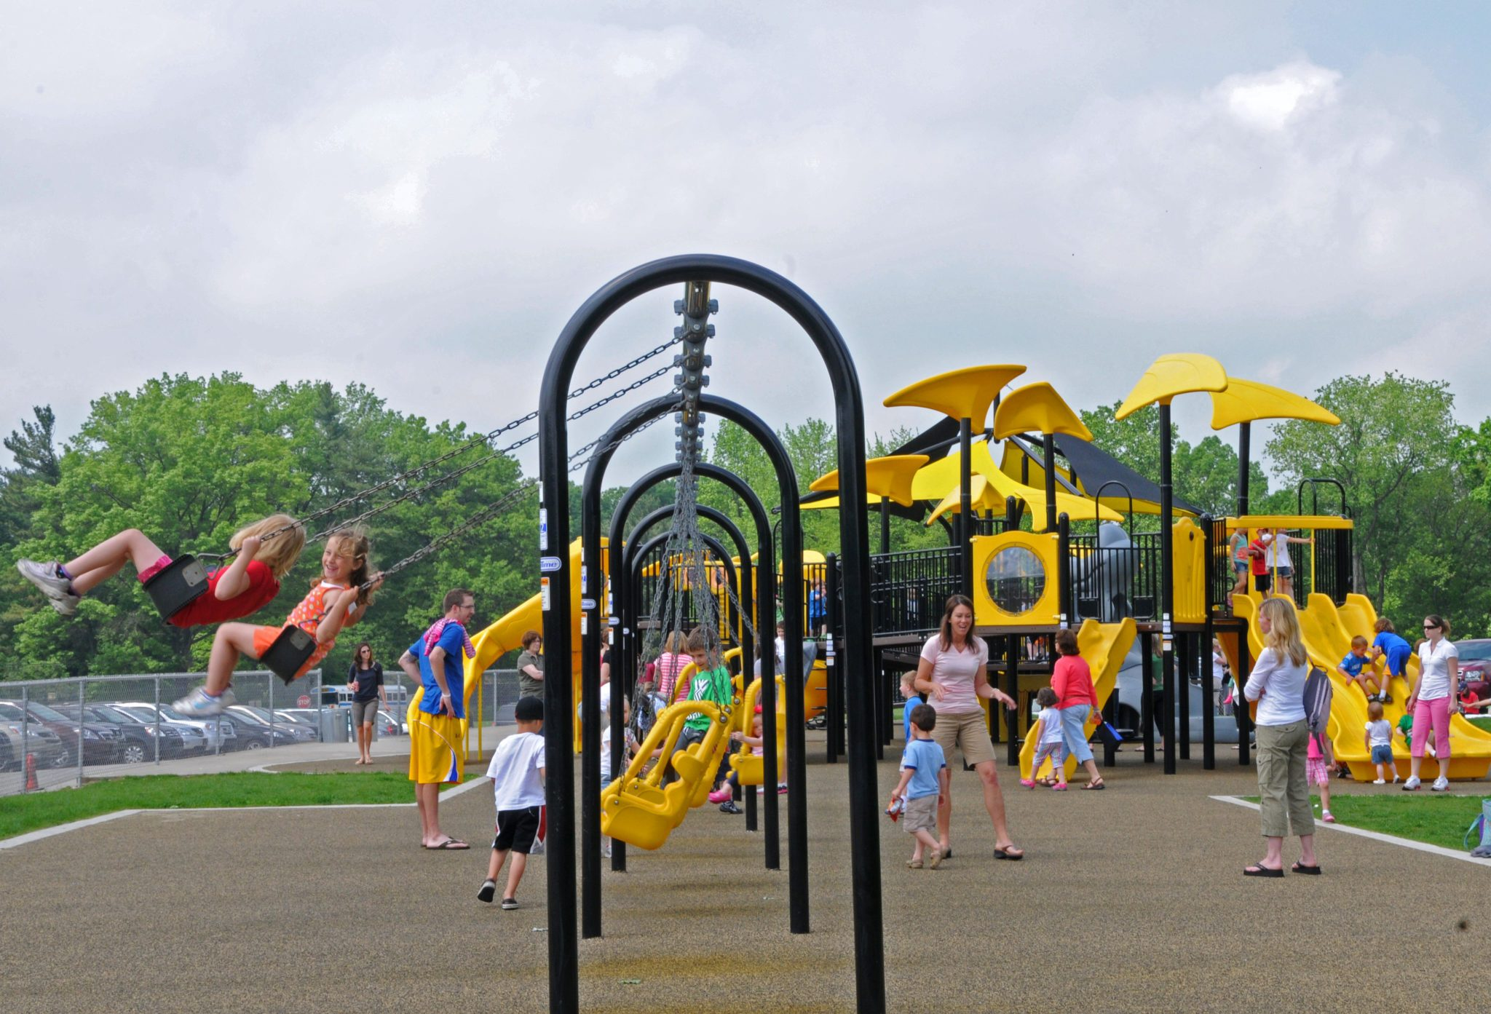
Top 5 Neighborhoods By Playground Data
Squirrel Hill South = 11.2 pts
Beechview = 7.1 pts
South Side Slopes = 6.4
Sheraden = 5.3
Allegheny Center = 5.2

Slide 11
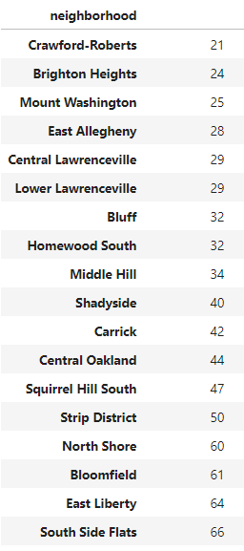
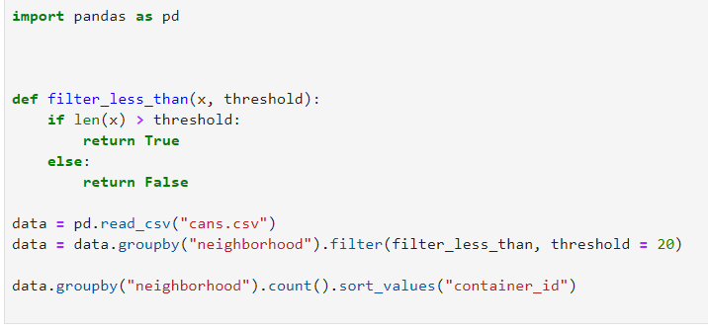
Smart Trash Cans
Smart trash cans are trash cans with sensors that notify city workers when they are full and many have a recycling attachment. Using the following code we generated a list of the top neighborhoods

Slide 12
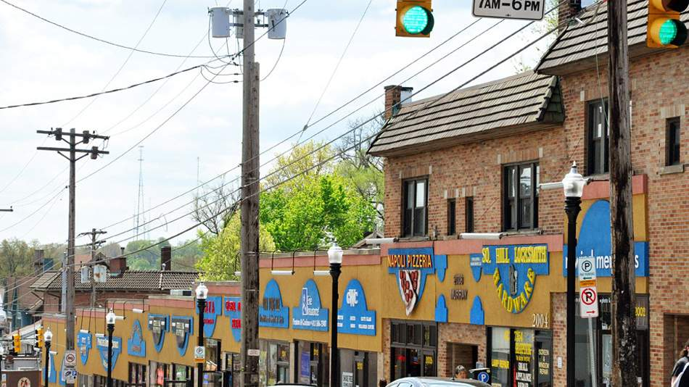
Final Score
We scored the Smart Trash Cans as 0.1 points per can, or one point for every 10 cans. South Side Flats had the most cans with 66 giving them 6.6 points. However, Squirrel Hill South had 47 cans giving them a final score of 15.9 making Squirrel Hill South the winner!

Slide 13
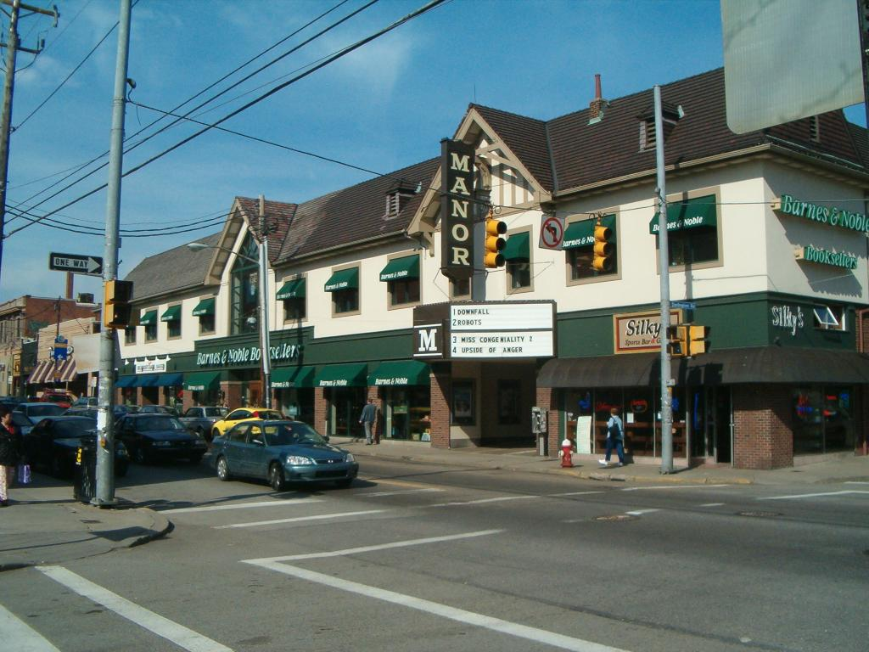
Outliers, Errors, and Inconclusive Data
Squirrel Hill North had data of 1 existing playground. However, no data was released on the playground equipment # of that neighborhood. But unless Wightman Park has 42 pieces of playground equipment, it would not be substantial enough to disrupt the top 5 results.
Another source of inaccuracy is that all of our criteria, especially the trash cans is affected by how large the area is, giving larger neighborhoods an advantage.

Slide 14
Conclusion
To no surprise, the top neighborhood comes out to be Squirrel Hill South. This neighborhood was the winner in both # of playgrounds and # of playground equipment in a neighborhood, and it was also a high scorer for smart trash cans. Out of all the data sets used, the trash can data was the least helpful in terms of deciding the best neighborhoods, which was expected. We expected the other two data sets to give us the best results for deciding the best neighborhood. When thinking about adding any other additional data to our original data we were having trouble finding ones that correlated with the ones we already had. (e.g. Does the amount of playgrounds have an effect on drug-related activity?) Having the chance to manipulate large data sets to find the best neighborhood out of so many others was really eye opening. Seeing what each neighborhood had to offer its visitors in terms of # of playgrounds, # of equipment, and # of Smart Trash cans in a neighborhood is a good way to show how the neighborhood cares for all those who visit/live there.

Slide 15
Questions?

